Slide 1

Implementation:
Language: Python 3.8+
Code Editor: Visual Studio Code
Github/git version 2.55.0
DATA 5010 · CLASS PARTICIPATION QUESTION 3
Designing a Vending Machine with
Object-Oriented Python
Ref: zyBook Chapter 9: Classes
By Sarah Omosule
Notes:
Introduce yourself, the course, and the activity.
20-minute presentation on Question 3 (Vending Machine) from the OOP class participation set,
10 minutes of Q&A.

Slide 2
Overview
1
The problem
2
Why objects
The Q3 - Class Participation Activity
Week 06 (Sep 28): Introduction to Object-Oriented Programming
Grouping data and determine the behaviour of each object/item
3
Class design and Code
4
Interface & customization
Attributes, methods, constructor defaults
Public vs. internal methods, __str__, __eq__
5
Results
6
Wrap-up
Walkthrough, tests, effectiveness, efficiency
Advantages, limitations, next steps, GitHub
Notes:
Roadmap – 30secs

Slide 3

The Problem: Question 3 — Vending Machine
1
Given three integers as user inputs that represent the number of bottles of drinks to
purchase, to restock, and to purchase afterward, create a VendingMachine object that
performs the following operations:
• Purchase the first input number of bottles of drinks
• Restock the second input number of bottles of drinks
• Purchase the last input number of bottles of drinks
• Report inventory
A VendingMachine's initial inventory is 20 bottles of drinks.
Notes:
Read the spec aloud, then walk through the arithmetics

Slide 4
The Problem: Question 3 — Key Inputs
1
Given three integers:
  bottles to purchase, (5)
  to restock, (2)
  and to purchase again. (7)
Task: Create a VendingMachine object and perform the operations in that order.
Starting inventory: always 20 bottles
Report the final inventory in one line of output.
EXAMPLE
Input:
5
2
7
Output:
Inventory: 10 bottles
20 (start) − 5 (purchase) + 2 (restock) − 7 (purchase) = 10
Start
purchase(5)
restock(2)
purchase(7)
report_inventory()
inventory = 20
inventory = 15
inventory = 17
inventory = 10
"Inventory: 10 bottles"
Each arrow is one method call. Inventory only ever changes inside purchase() and restock() -- never directly.
Notes:
Start at 20, subtract 5, add 2, subtract 7, land on 10. Inventory: 10 – to run using code

Slide 5
Why Model This as an Object?
2
An object groups data (attributes) with the operations that act on that data (methods).
A real vending machine hides its internal mechanics -- you interact with buttons, not gears
Our VendingMachine class does the same:
  Inventory is internal data
  purchase()/restock() are the buttons/coin slot.
Class: VendingMachine
Coin slot · buttons - displayed
Internal wiring - hidden
Data
(Information Hidden)
Operations/Methods
inventory
total_purchased
total_restocked
purchase()
restock()
report_inventory()
Notes:
Like a real machine hides its gears behind buttons, our class hides the inventory variable behind purchase/restock methods
- abstraction - 9.1.

Slide 6
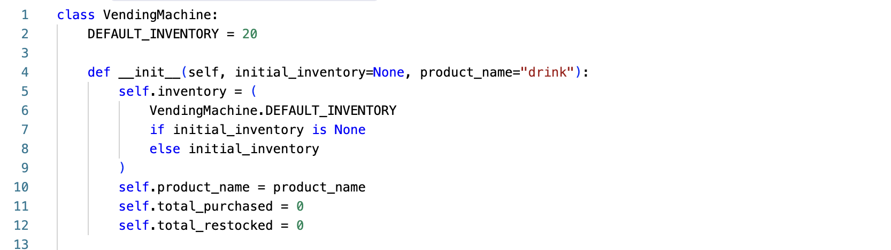
Class Design
3
VendingMachine
Class attribute
DEFAULT_INVENTORY = 20
*Higher-level objects
Instance attributes
Methods (public interface)
*Lower-level items
inventory
product_name
total_purchased
total_restocked
__init__(initial_inventory=None, product_name="drink")
purchase()
restock()
report_inventory()
__str__ / __eq__ (customization)
_has_enough_stock(amount) -- internal method, not part of the public interface / POTENTIALLY DEALLOCATED
Notes:
class attribute shared by all machines, four instance attributes unique per machine, and a small set of public methods and one internal helper.
zyBook 9.2-4

Slide 7
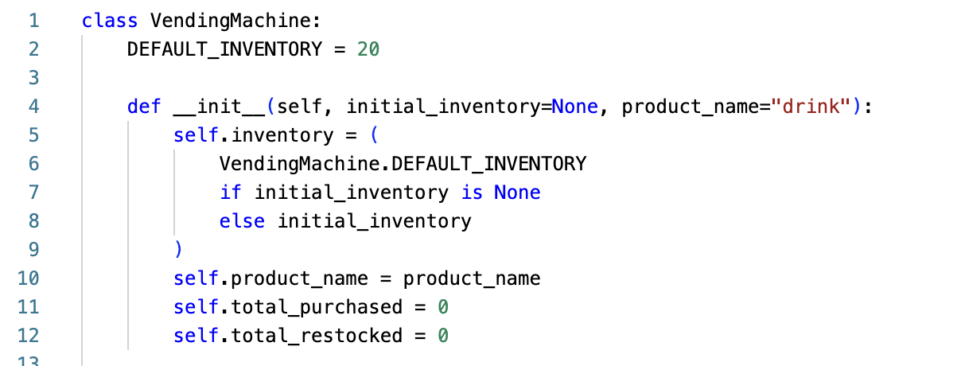
Constructor with Default Parameters
3
Default parameter values let a caller skip arguments for the common case
initial_inventory defaults to None, then falls back to the class attribute DEFAULT_INVENTORY (20)
product_name defaults to "drink" -- useful for the __str__ output later
Every instance maintains its own independent attributes (like inventory and product name), even though DEFAULT_INVENTORY is shared
Notes:
VendingMachine() with no arguments still works because of the default.
- RaceTime/Employee default-parameter examples from zyBook 9.6

Slide 8
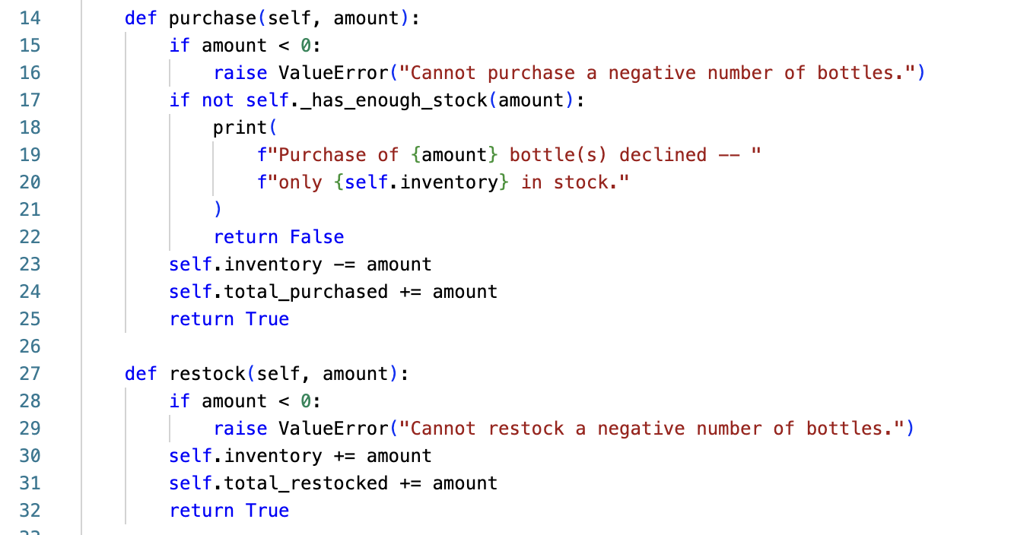
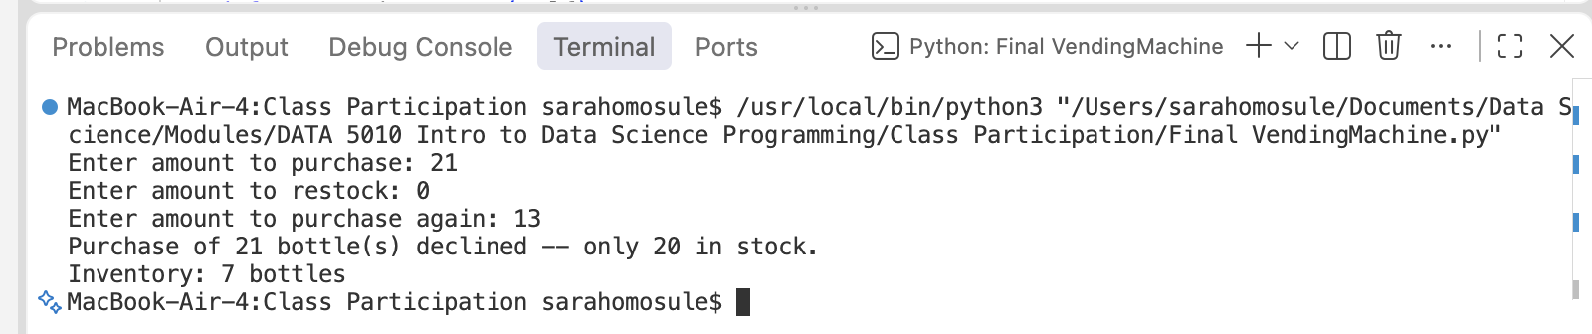
Instance Methods: purchase() and restock()
3
How many bottles do you want to buy?
self is bound automatically to the instance the method is called on
restock() is the mirror image: it always succeeds and increases inventory.
Both methods validate their input before touching state. Therefore, a bad call can't corrupt the object.
purchase() returns True/False so calling code can react to a declined sale.

Slide 9
Encapsulation & the Class Interface
4
As you can see, we are interacting with the internal helper (knots, bolts and wires of the machine)
A class interface: the set of methods a caller is meant to use.
purchase(), restock(), and report_inventory() are the public interface.
_has_enough_stock() starts with an underscore
  a convention signaling "internal use only.”
  This method is never called directly
We now that python can't truly enforce privacy, but the underscore documents intent clearly.
Encapsulation ensures that customer only interacts with the public interface (Purchase() / restock() / report_inventory()) while hiding the internal machinery (_has_enough_stock()) so outsiders can't mess up the internal logic.
Public interface
purchase() restock() report_inventory()
Internal helper
_has_enough_stock()
Notes:
Explain the arrow: public methods call the internal helper, but callers of the class never need to call _has_enough_stock() directly – we separate interface from implementation.

Slide 10
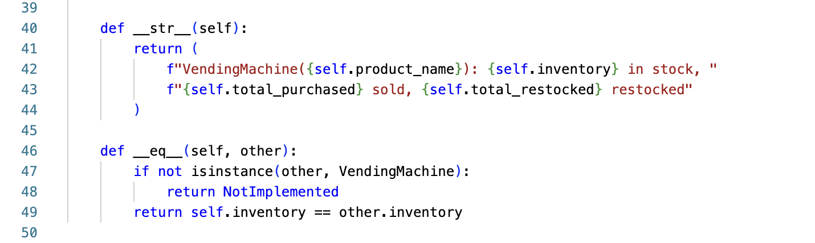
Class Customization: __str__
4
Special method names let a class control built-in behavior like printing and comparison.
__str__ replaces the default '<VendingMachine object...>' with a readable summary.

Slide 11
5
Testing Results: Effectiveness using Class Customization
Class customization is tested too: two machines holding the same inventory compare as equal
__eq__ lets two machines be compared directly with == based on current inventory.
”self” is bound to the left operand (MACHINE A)
”other” is bound to the right operand (MACHINE B)
Unit Test
machine_a == machine_b → True only if both machines currently hold the same inventory count

Slide 12
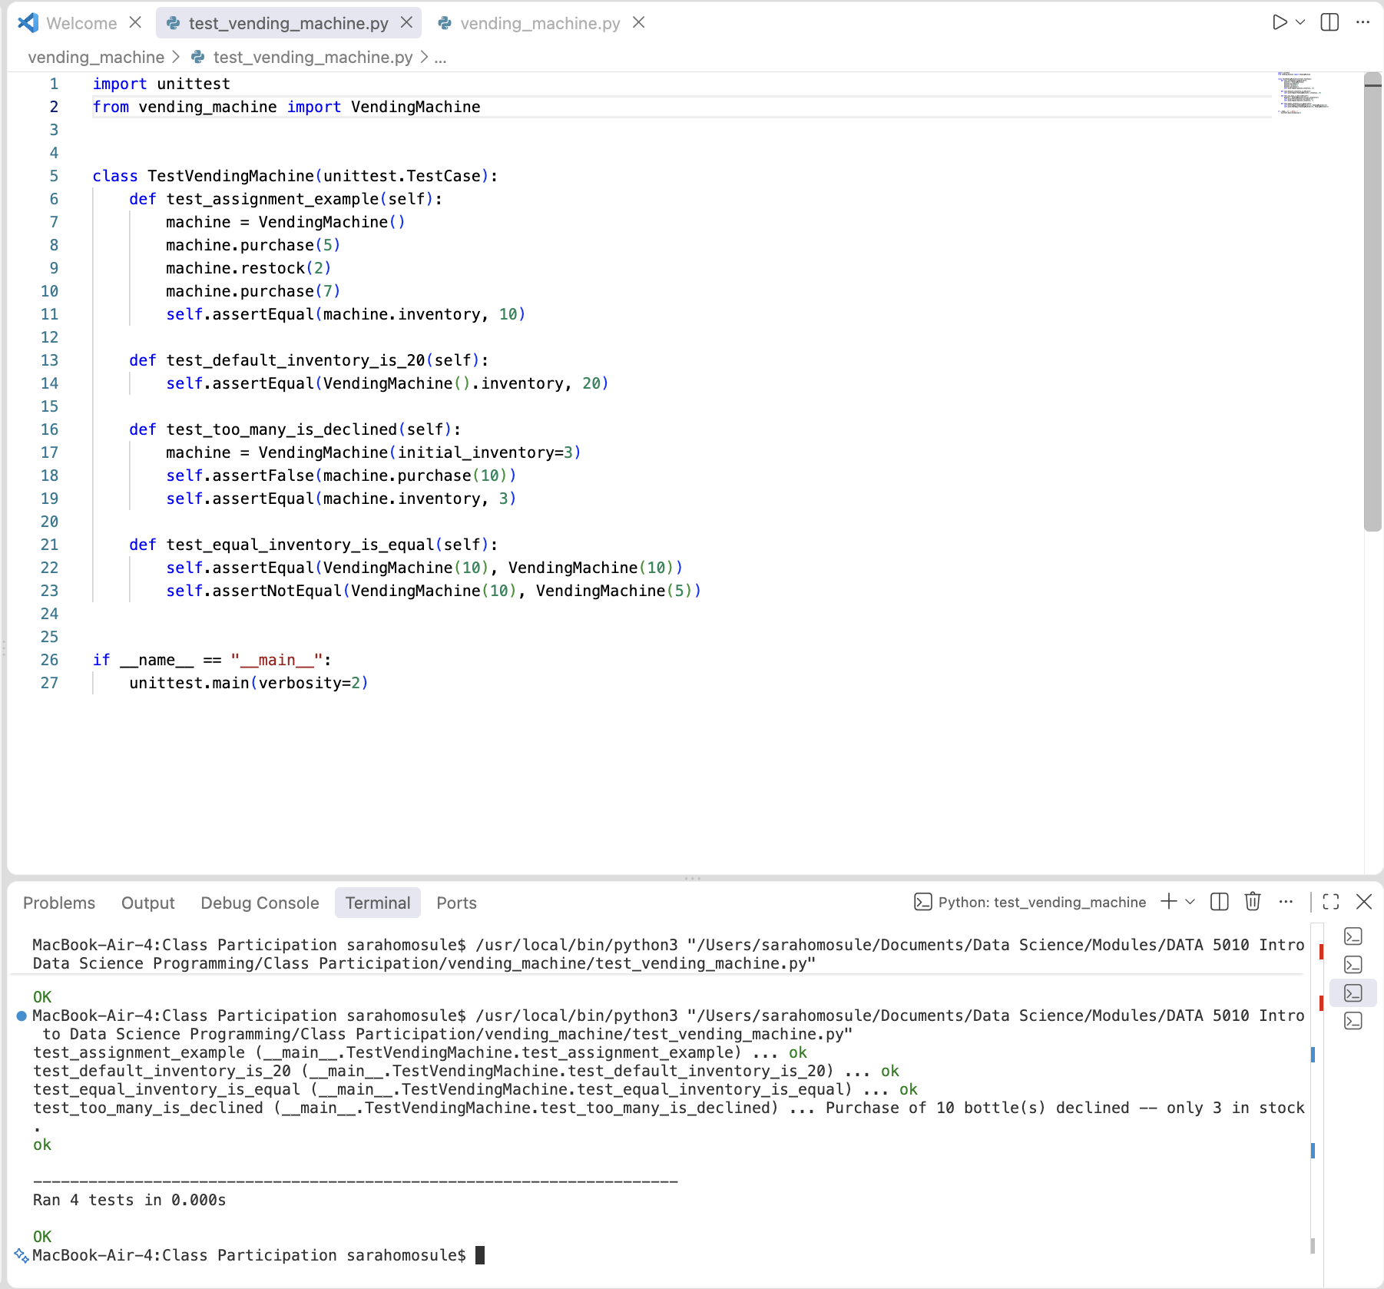
Testing Results: Effectiveness
5
Purpose: proves that different machines (which takes the self and other arguments) operate completely independently without messing up each other's data
Main question:
- Does the VendingMachine code work correctly under normal conditions?
- Does it handle bad inputs safely without crashing?
- Does it keep separate machines completely independent?
The unit tests, on the right, define four test functions inside a class that inherits from unittest.TestCase.
Each test sets up a scenario, runs a method (purchase, restock), and uses self.assertEqual() or self.assertFalse() to check if the outcome matches expectations, and just automatically runs the test.
Effectiveness test ref:
https://youtu.be/6tNS--WetLI?si=uca9Ascwsr3Ltaw4
Notes:
Test 1: I use the standard input example to test if output = 10
Purchase 5 bottles,
Restock 2 bottles,
Repurchase 7
Test 2: test_default_inventory_is_20(self), to check that a brand new/random machine starts with 20 items
Test 3: An edge case (extreme case): test_too_many_is_declined(self)
If VM’s initial_inventory = 3 items
And someone tries to purchase(10)
Purchase is declined using assertFalse() method, which TRUE/OK
We freeze inventory at 3
Test 4: test_equal_inventory is equal
Tests out __eq__ method
Verifies that two separate machines that have the same inventory are evaluated as equal.
Terminal: OK – all tests work precisely as intended

Slide 13

Efficiency: Time & Space
purchase() and restock() do a fixed number of comparisons and arithmetic ops
  no loops, no dependence on inventory size.
Memory is fixed per instance: four attributes, regardless of how many purchases have happened over the machine's lifetime.
Automatic Management: Relies on Python's runtime memory allocation, reference counting, and garbage collection.
Since it is a small activity (input size of only 3), efficiency isn't the bottleneck -- correctness and clear structure are what the design optimizes for.
When writing inventory data to a file, using append mode ("a") when we reopen the file ensures that we add new stock updates or transactions without overwriting or wiping out our existing records. Our inventory data from the last caller/customer stays intact and is not reset.
Notes:
there's no algorithmic complexity
constant time and space
counters like total_purchased don't grow the object's size, just its values

Slide 14
Advantages, Limitations & Next Steps
Advantages
Limitations & future work
Inventory can never go negative -- guarded in one place
Public interface is small and predictable
__str__/__eq__ make debugging and comparisons easy
Fully covered by 4 passing unit tests
Single product only -- no prices or product types
No payment/change handling
No maximum capacity on restocking
No persistence -- state resets every run
Next: a Product class, a dict of inventories, and file/Database of input data/stock

Slide 15
Code & Tests on GitHub
https://github.com/somosule/DATA5010.git
vending_machine.py – MAIN VendingMachine assignment and main() driver
test_vending_machine.py -- 4 unit tests, all passing
README.md -- setup, run, and test instructions
Questions?

Slide 16
Notes: Key Terms Used in Our Code
Class object
A factory for creating new class instances.
In our code: class VendingMachine (line 1). Calling VendingMachine() in main() (line 57) uses it.
Instance object
Represents a single instance of a class.
In our code: machine in main() (line 57) is one vending machine. Inside methods, self is that machine; in __eq__, other is a second one.
Instance method
Functions that are also class attributes; each one takes self and works on one instance.
In our code: __init__, purchase, restock, report_inventory, _has_enough_stock, __str__ and __eq__.
Instance attribute
A variable that exists in a single instance.
In our code: self.inventory, self.product_name, self.total_purchased and self.total_restocked (lines 5, 10, 11, 12).
Class attribute
A variable shared with all instances of a class.
In our code: DEFAULT_INVENTORY = 20 (line 2), read on line 6 as VendingMachine.DEFAULT_INVENTORY.

Slide 17
Key Terms:
1) Class and Instance Initialised
CLASS OBJECT (1): class VendingMachine is the factory that creates every machine.
CLASS ATTRIBUTE (2): DEFAULT_INVENTORY = 20 is one value shared by all machines.
INSTANCE METHOD (4): __init__ is a function inside the class. It runs each time a machine is created.
INSTANCE ATTRIBUTES (5, 10, 11, 12): self.inventory, self.product_name, self.total_purchased and self.total_restocked. Each machine gets its own unique copy.
CLASS ATTRIBUTE, read (6): when no starting stock is given, the shared 20 is read through VendingMachine.DEFAULT_INVENTORY.
INSTANCE OBJECT: self is the machine being built. The machine itself is created in main() (last code slide).
Class object
Instance object
Instance method
Instance attribute
Class attribute
Notes:
Line 1 is the class object: a factory that can build any number of vending machines. Line 2 is a class attribute. DEFAULT_INVENTORY equals 20 is written once and shared by every machine, so it is the default starting stock. Line 4 is an instance method, the constructor __init__.
Python calls it automatically every time a new machine is created, and self is the new machine. Lines 5, 10, 11 and 12 create the instance attributes: inventory, product_name, total_purchased and total_restocked. These belong to one machine only, so two machines never share them. Line 6 shows the two ideas meeting: if the caller gives no starting stock, the instance attribute inventory is filled from the shared class attribute, VendingMachine.DEFAULT_INVENTORY. Key contrast to say out loud: the class attribute is shared by all machines, the instance attributes are private to each machine.

Slide 18
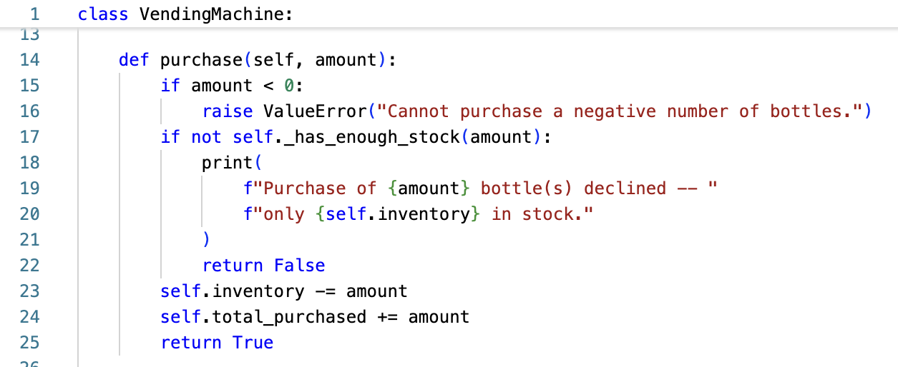
Key Terms:
2) Defining Methods: Purchase
INSTANCE METHOD (line 14): purchase(self, amount) is defined inside the class, so every machine can use it. self is the instance object it is called on.
Lines 15-16: a negative amount raises ValueError, so bad input is rejected.
INSTANCE METHOD (line 17): self._has_enough_stock(amount) calls another instance method on the same machine.
INSTANCE ATTRIBUTE (line 20): self.inventory tells the user how much stock is left. If stock is too low the sale is declined (line 22, return False) and nothing changes.
INSTANCE ATTRIBUTES (lines 23-24): self.inventory -= amount lowers this machine's stock, and self.total_purchased += amount adds to its own running total.
Line 25: return True tells the caller the sale worked. Other machines are not affected.
Class object
Instance object
Instance method
Instance attribute
Class attribute
Notes:
Purchase method: Line 14 defines an instance method: a function stored in the class that always takes self first. When we later write machine.purchase(5), Python passes machine in as self, so the method knows which machine to change. Lines 15 and 16 protect against a negative amount. Line 17 calls a second instance method, _has_enough_stock, on the same machine. If there is not enough stock, lines 18 to 22 print a message that reads the instance attribute self.inventory, then return False, and the inventory is untouched. Otherwise lines 23 and 24 update two instance attributes: self.inventory goes down, and self.total_purchased goes up. Because these are instance attributes, only this machine changes. Line 25 returns True to say the purchase succeeded.

Slide 19
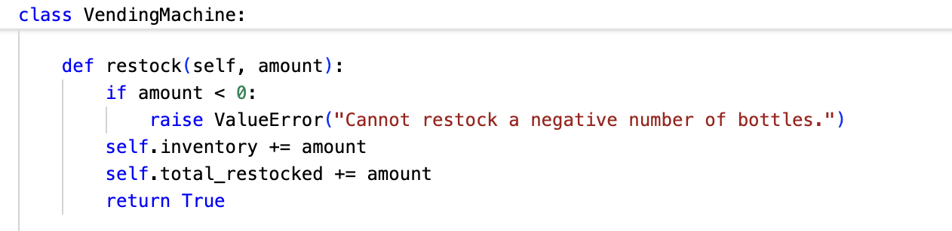
Key Terms:
3) Defining Methods: Restock
INSTANCE METHOD: restock(self, amount) mirrors purchase(): another function in the class that works on one machine (self). A negative amount raises ValueError.
INSTANCE ATTRIBUTES: self.inventory += amount adds bottles to this machine, and self.total_restocked += amount updates its own restock counter.
return True confirms success. Restocking cannot fail, so there is no 'not enough stock' check.
Class object
Instance object
Instance method
Instance attribute
Class attribute
Notes:
Restock is the mirror image of purchase. It is another instance method, so it starts with self and works on one specific machine. The guard clause rejects negative amounts. Then two instance attributes change: self.inventory goes up by the amount, and self.total_restocked records how much has been added over the machine's life. There is no out-of-stock check because adding bottles can always succeed. It returns True. Point out that each machine would keep its own inventory and its own counter, which is exactly what makes them instance attributes and not class attributes.

Slide 20
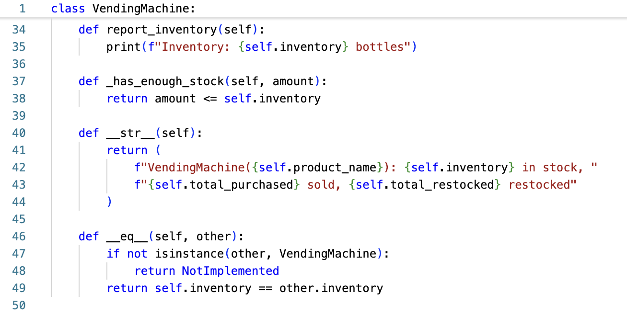
Key Terms:
4) Defining Methods: Report
INSTANCE METHOD (line 34): report_inventory(self) prints this machine's stock. Line 35 reads the instance attribute self.inventory.
INSTANCE METHOD (line 37): _has_enough_stock(self, amount) is an internal helper (the underscore means internal use). Line 38 compares amount with self.inventory.
INSTANCE METHOD (line 40): __str__ controls what print(machine) shows. Lines 42-43 combine four instance attributes: product_name, inventory, total_purchased, total_restocked.
INSTANCE METHOD (line 46): __eq__ compares two instance objects. Line 49: self.inventory (this machine) == other.inventory (the other machine).
Class object
Instance object
Instance method
Instance attribute
Class attribute
Notes:
These are the remaining instance methods. report_inventory on line 34 prints the final answer the assignment asks for, using the instance attribute self.inventory. _has_enough_stock on line 37 is the internal helper that purchase calls; the leading underscore is a signal that it is not part of the public interface. __str__ on line 40 is a special method: it decides what print(machine) displays, and it reads four instance attributes. __eq__ on line 46 lets us compare two machines with the double equals sign. This is a good place to mention two instance objects at once: self is one machine and other is a different machine, and line 49 compares their inventory attributes. None of these methods change the stock, they only read it.

Slide 21
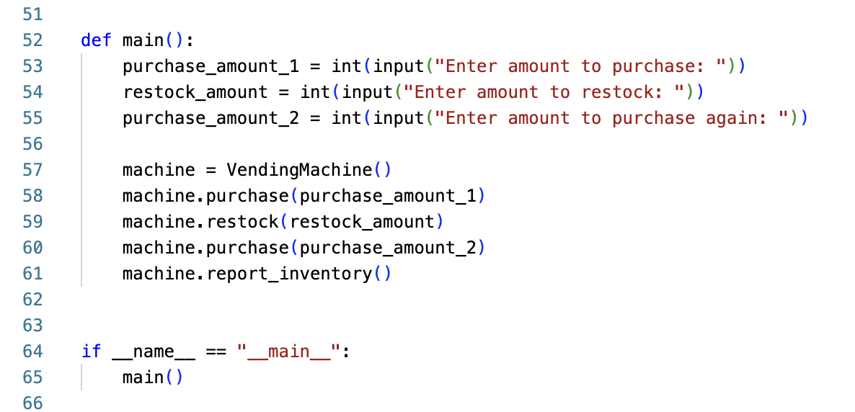
Key Terms:
5) Creating the Instance and Calling Its Methods
main() is not indented under the class, so it sits outside VendingMachine: it uses the class, it is not part of it.
Lines 53-55 read three numbers: the first purchase, the restock, and the second purchase.
CLASS OBJECT (line 57): VendingMachine() calls the factory.
INSTANCE OBJECT: it returns one machine, stored in the variable machine.
INSTANCE METHODS (lines 58-61): purchase, restock, purchase and report_inventory all run on that same machine. Nothing is reassigned and no new machine is made, so the stock carries through: 20, 15, 17, 10. The second purchase (7) starts from 17, not 20.
Class object
Instance object
Instance method
Instance attribute
Class attribute
* No longer under class loop
Notes:
Where the class is actually used. main() is not indented under the class, so it is outside it: it uses VendingMachine rather than being part of it. Lines 53 to 55 read the three numbers. Line 57 is the key line: VendingMachine() calls the class object, the factory, and it returns one instance object, which we store in the variable machine. Lines 58 to 61 then call instance methods on that one machine: purchase 5, restock 2, purchase 7, then report. Because it is the same instance object each time, the attributes carry over: 20 becomes 15, then 17, then 10. That answers the repurchase question: the second purchase does not start again from 20, because no new machine was created and nothing was reassigned. The last method prints Inventory: 10 bottles.

